Slide 1

Analysis of Algorithms
CS 477/677
Shortest Paths
Instructor: George Bebis
Chapter 24

Slide 2
Shortest Path Problems
How can we find the shortest route between two points on a road map?
Model the problem as a graph problem:
  Road map is a weighted graph:
  vertices = cities
  edges = road segments between cities
  edge weights = road distances
  Goal: find a shortest path between two vertices (cities)

Slide 3
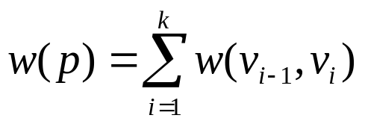
Shortest Path Problem
Input:
  Directed graph G = (V, E)
  Weight function w : E → R
Weight of path p = ⟨v₀, v₁, . . . , v_{k}⟩
Shortest-path weight from u to v:
δ(u, v) = min w(p) : u v if there exists a path from u to v
∞ otherwise
Note: there might be multiple shortest paths from u to v
t
x
3
6
9
3
4
s
0
2
1
2
7
5
3
5
11
6
y
z
p

Slide 4
Variants of Shortest Path
Single-source shortest paths
  G = (V, E) ⇒ find a shortest path from a given source vertex s to each vertex v ∈ V
Single-destination shortest paths
  Find a shortest path to a given destination vertex t from each vertex v
  Reversing the direction of each edge ⇒ single-source

Slide 5
Variants of Shortest Paths (cont’d)
Single-pair shortest path
  Find a shortest path from u to v for given vertices u and v
All-pairs shortest-paths
  Find a shortest path from u to v for every pair of vertices u and v

Slide 6
Negative-Weight Edges
Negative-weight edges may form negative-weight cycles
If such cycles are reachable from
the source, then δ(s, v) is not properly
defined!
  Keep going around the cycle, and get
  w(s, v) = - ∞ for all v on the cycle
a
b
-4
3
4
c
6
d
g
s
0
5
8
y
-3
2
3
7
e
-6
f

Slide 7
Negative-Weight Edges
s → a: only one path
δ(s, a) = w(s, a) = 3
s → b: only one path
δ(s, b) = w(s, a) + w(a, b) = -1
s → c: infinitely many paths
⟨s, c⟩, ⟨s, c, d, c⟩, ⟨s, c, d, c, d, c⟩
cycle has positive weight (6 - 3 = 3)
⟨s, c⟩ is shortest path with weight δ(s, b) = w(s, c) = 5
a
b
3
-4
-1
3
4
c
6
d
g
s
0
5
5
11
8
-∞
y
-3
2
3
7
-∞
-∞
e
-6
f

Slide 8
Negative-Weight Edges
s → e: infinitely many paths:
  ⟨s, e⟩, ⟨s, e, f, e⟩, ⟨s, e, f, e, f, e⟩
  cycle ⟨e, f, e⟩ has negative weight:
  3 + (- 6) = -3
  can find paths from s to e with arbitrarily large negative weights
  δ(s, e) = - ∞ ⇒ no shortest path exists between s and e
  Similarly: δ(s, f) = - ∞, δ(s, g) = - ∞
a
b
3
-4
-1
3
4
c
6
d
g
s
0
5
5
11
8
-∞
y
-3
2
3
7
-∞
-∞
e
-6
f
h
i
∞
2
∞
h, i, j not
reachable
from s
-8
3
∞
j
δ(s, h) = δ(s, i) = δ(s, j) = ∞

Slide 9
Cycles
Can shortest paths contain cycles?
Negative-weight cycles
  Shortest path is not well defined
Positive-weight cycles:
  By removing the cycle, we can get a shorter path
Zero-weight cycles
  No reason to use them
  Can remove them to obtain a path with same weight
No!
No!

Slide 10
Optimal Substructure Theorem
Given:
  A weighted, directed graph G = (V, E)
  A weight function w: E → R,
  A shortest path p = ⟨v₁, v₂, . . . , v_{k}⟩ from v₁ to v_{k}
  A subpath of p: p_{ij} = ⟨v_{i}, v_{i+1}, . . . , v_{j}⟩, with 1 ≤ i ≤ j ≤ k
Then: p_{ij} is a shortest path from v_{i} to v_{j}
Proof: p = v₁ v_{i} v_{j} v_{k}
w(p) = w(p_{1i}) + w(p_{ij}) + w(p_{jk})
Assume ∃ p_{ij}’ from v_{i} to v_{j} with w(p_{ij}’) < w(p_{ij})
⇒ w(p’) = w(p_{1i}) + w(p_{ij}’) + w(p_{jk}) < w(p) contradiction!
v_{j}
p_{ij}
p_{jk}
v₁
p_{1i}
p_{ij}’
v_{k}
v_{i}
p_{1i}
p_{ij}
p_{jk}

Slide 11
Triangle Inequality
For all (u, v) ∈ E, we have:
δ (s, v) ≤ δ (s, u) + δ (u, v)
- If u is on the shortest path to v we have the equality sign
s
u
v
s
u
v

Slide 12
Algorithms
Bellman-Ford algorithm
  Negative weights are allowed
  Negative cycles reachable from the source are not allowed.
Dijkstra’s algorithm
  Negative weights are not allowed
Operations common in both algorithms:
  Initialization
  Relaxation

Slide 13
Shortest-Paths Notation
For each vertex v ∈ V:
δ(s, v): shortest-path weight
d[v]: shortest-path weight estimate
  Initially, d[v]=∞
  d[v]→δ(s,v) as algorithm progresses
π[v] = predecessor of v on a shortest path from s
  If no predecessor, π[v] = NIL
  π induces a tree—shortest-path tree
t
x
3
6
9
3
4
s
0
2
1
2
7
5
3
5
11
6
y
z

Slide 14
Initialization
Alg.: INITIALIZE-SINGLE-SOURCE(V, s)
for each v ∈ V
do d[v] ← ∞
π[v] ← NIL
d[s] ← 0
All the shortest-paths algorithms start with INITIALIZE-SINGLE-SOURCE

Slide 15
Relaxation Step
Relaxing an edge (u, v) = testing whether we can improve the shortest path to v found so far by going through u
  If d[v] > d[u] + w(u, v)
  we can improve the shortest path to v
  ⇒ d[v]=d[u]+w(u,v)
  ⇒ π[v] ← u
After relaxation:
  d[v] ≤ d[u] + w(u, v)
s
s
u
v
u
v
5
2
9
5
2
6
RELAX(u, v, w)
RELAX(u, v, w)
u
v
u
v
5
2
7
5
2
6
no change

Slide 16
Bellman-Ford Algorithm
Single-source shortest path problem
  Computes δ(s, v) and π[v] for all v ∈ V
Allows negative edge weights - can detect negative cycles.
  Returns TRUE if no negative-weight cycles are reachable from the source s
  Returns FALSE otherwise ⇒ no solution exists

Slide 17
Bellman-Ford Algorithm (cont’d)
Idea:
  Each edge is relaxed |V–1| times by making |V-1| passes over the whole edge set.
  To make sure that each edge is relaxed exactly |V – 1| times, it puts the edges in an unordered list and goes over the list |V – 1| times.
(t, x), (t, y), (t, z), (x, t), (y, x), (y, z), (z, x), (z, s), (s, t), (s, y)
t
5
x
∞
∞
6
-2
-3
s
0
8
7
-4
7
2
∞
∞
9
y
z

Slide 18
BELLMAN-FORD(V, E, w, s)
t
5
x
Pass 1
t
5
x
∞
∞
∞
∞
6
6
-2
6
-2
-3
-3
0
8
7
s
0
8
7
s
-4
-4
7
2
7
2
∞
∞
∞
∞
7
9
9
y
z
y
z
E: (t, x), (t, y), (t, z), (x, t), (y, x), (y, z), (z, x), (z, s), (s, t), (s, y)

Slide 19
Example
(t, x), (t, y), (t, z), (x, t), (y, x), (y, z), (z, x), (z, s), (s, t), (s, y)
t
5
x
t
x
Pass 1
(from
previous
slide)
Pass 2
5
6
∞
6
∞
4
11
6
-2
6
-2
-3
-3
s
0
8
7
8
7
s
0
-4
-4
7
2
7
2
7
∞
7
∞
9
2
y
z
9
y
z
Pass 3
t
5
x
Pass 4
t
5
x
6
∞
6
∞
2
4
2
11
4
11
6
-2
6
-2
-3
-3
s
0
8
7
0
8
7
s
-4
-4
7
2
7
2
7
∞
7
∞
2
2
9
9
-2
y
z
y
z

Slide 20
Detecting Negative Cycles
(perform extra test after V-1 iterations)
for each edge (u, v) ∈ E
do if d[v] > d[u] + w(u, v)
then return FALSE
return TRUE
s
b
0
2
∞
-8
3
∞
c
1st pass
2nd pass
s
b
s
b
Look at edge (s, b):
d[b] = -1
d[s] + w(s, b) = -4
⇒ d[b] > d[s] + w(s, b)
0
2
∞
-3
2
2
-3
2
-6
-1
-8
3
-8
3
∞
5
5
2
c
c
(s,b) (b,c) (c,s)

Slide 21
BELLMAN-FORD(V, E, w, s)
INITIALIZE-SINGLE-SOURCE(V, s)
for i ← 1 to |V| - 1
do for each edge (u, v) ∈ E
do RELAX(u, v, w)
for each edge (u, v) ∈ E
do if d[v] > d[u] + w(u, v)
then return FALSE
return TRUE
Running time: O(V+VE+E)=O(VE)
Θ(V)
O(V)
O(VE)
O(E)
O(E)

Slide 22
Shortest Path Properties
Upper-bound property
  We always have d[v] ≥ δ (s, v) for all v.
  The estimate never goes up – relaxation only lowers the estimate
v
5
x
v
5
x
6
∞
6
∞
4
2
4
11
11
6
-2
Relax (x, v)
6
-2
-3
-3
s
0
8
7
s
0
8
7
-4
-4
7
2
7
2
7
∞
7
∞
2
2
9
9
y
z
y
z

Slide 23
Shortest Path Properties
Convergence property
If s u → v is a shortest path, and if d[u] = δ(s, u) at any time prior to relaxing edge (u, v), then d[v] = δ(s, v) at all times after relaxing (u, v).
u
v
If d[v] > δ(s, v) ⇒ after relaxation:
  d[v] = d[u] + w(u, v)
  d[v] = 5 + 2 = 7
Otherwise, the value remains unchanged, because it must have been the shortest path value
2
6
∞
5
8
11
5
s
0
4
4
7

Slide 24
Shortest Path Properties
Path relaxation property
Let p = ⟨v₀, v₁, . . . , v_{k}⟩ be a shortest path from s = v₀ to v_{k}. If we relax, in order, (v₀, v₁), (v₁, v₂), . . . , (v_{k-1}, v_{k}), even intermixed with other relaxations, then d[v_{k} ] = δ (s, v_{k}).
v₁
2
v₂
d[v₂] = δ (s, v₂)
6
∞
v₄
∞
∞
11
5
7
∞
5
3
14
d[v₁] = δ (s, v₁)
4
v₃
s
0
∞
d[v₄] = δ (s, v₄)
11
d[v₃] = δ (s, v₃)

Slide 25
Correctness of Belman-Ford Algorithm
Theorem: Show that d[v]= δ (s, v), for every v, after |V-1| passes.
Case 1: G does not contain negative cycles which are reachable from s
  Assume that the shortest path from s to v is
  p = ⟨v₀, v₁, . . . , v_{k}⟩, where s=v₀ and v=v_{k}, k≤|V-1|
  Use mathematical induction on the number of
  passes i to show that:
  d[v_{i}]= δ (s, v_{i}) , i=0,1,…,k

Slide 26
Correctness of Belman-Ford Algorithm (cont.)
Base Case: i=0 d[v₀]= δ (s, v₀)= δ (s, s)= 0
Inductive Hypothesis: d[v_{i-1}]= δ (s, v_{i-1})
Inductive Step: d[v_{i}]= δ (s, v_{i})
s
After relaxing (v_{i-1}, v_{i}):
d[v_{i}]≤d[v_{i-1}]+w= δ (s, v_{i-1})+w= δ (s, v_{i})
v_{i-1}
v_{i}
w
d[v_{i-1}]= δ (s, v_{i-1})
From the upper bound property: d[v_{i}]≥ δ (s, v_{i})
Therefore, d[v_{i}]=δ (s, v_{i})

Slide 27
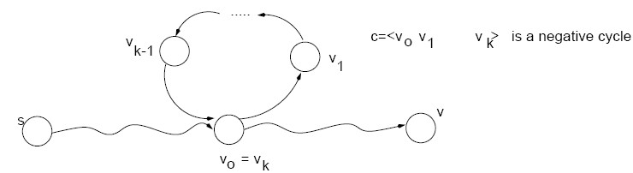
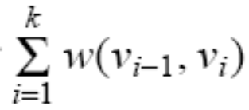
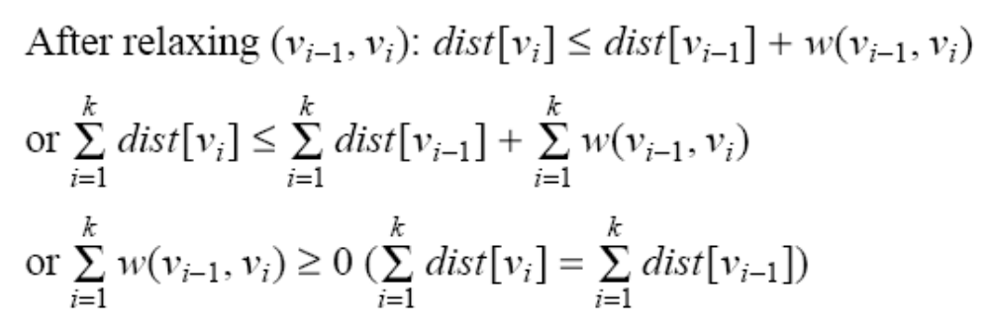
Correctness of Belman-Ford Algorithm (cont.)
Case 2: G contains a negative cycle which is reachable from s
<0
Proof by
Contradiction:
suppose the
algorithm
returns a
solution
d
d
d
d
d
d
Contradiction!

Slide 28
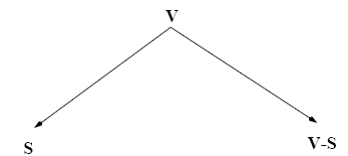
Dijkstra’s Algorithm
Single-source shortest path problem:
  No negative-weight edges: w(u, v) > 0, ∀ (u, v) ∈ E
Each edge is relaxed only once!
Maintains two sets of vertices:
d[v]=δ (s, v)
d[v]>δ (s, v)

Slide 29
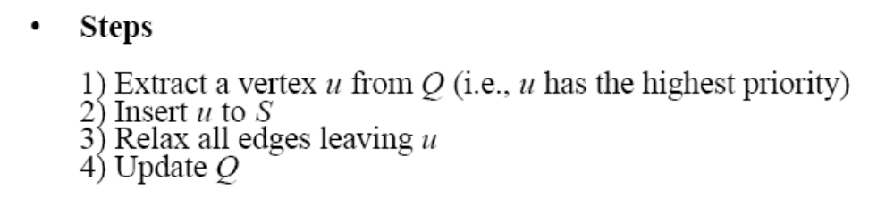
Dijkstra’s Algorithm (cont.)
Vertices in V – S reside in a min-priority queue
  Keys in Q are estimates of shortest-path weights d[u]
Repeatedly select a vertex u ∈ V – S, with the minimum shortest-path estimate d[u]
Relax all edges leaving u

Slide 30
Dijkstra (G, w, s)
S=<> Q=<s,t,x,z,y>
S=<s>
Q=<y,t,x,z>
t
1
x
t
x
∞
∞
1
∞
∞
10
10
9
10
9
s
0
2
3
4
6
2
3
4
6
s
0
5
7
7
5
∞
∞
∞
∞
2
5
2
y
z
y
z

Slide 31
Example (cont.)
t
1
x
t
1
x
10
∞
8
14
8
14
13
10
9
10
9
s
0
2
3
4
6
s
0
2
3
4
6
5
7
5
7
5
∞
5
7
7
2
2
y
z
y
z
S=<s,y> Q=<z,t,x>
S=<s,y,z> Q=<t,x>

Slide 32
Example (cont.)
S=<s,y,z,t> Q=<x>
S=<s,y,z,t,x> Q=<>
t
x
t
1
x
1
8
9
8
13
9
10
9
10
9
2
3
4
6
s
0
2
3
4
6
s
0
5
7
5
7
5
7
5
7
2
2
y
z
y
z

Slide 33
Dijkstra (G, w, s)
INITIALIZE-SINGLE-SOURCE(V, s)
S ← ∅
Q ← V[G]
while Q ≠ ∅
do u ← EXTRACT-MIN(Q)
S ← S ∪ {u}
for each vertex v ∈ Adj[u]
do RELAX(u, v, w)
Update Q (DECREASE_KEY)
Running time: O(VlgV + ElgV) = O(ElgV)
Θ(V)
O(V) build min-heap
Executed O(V) times
O(lgV)
O(VlgV)
O(E) times
(total)
O(ElgV)
O(lgV)

Slide 34
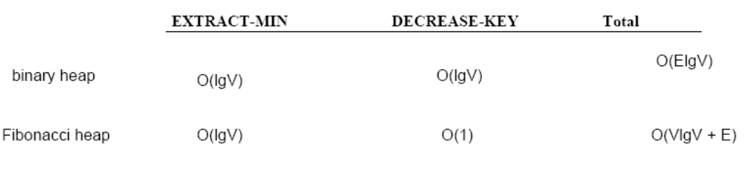
Binary Heap vs Fibonacci Heap
Running time depends on the implementation of the heap

Slide 35
Correctness of Dijskstra’s Algorithm
For each vertex u ∈ V, we have d[u] = δ(s, u) at the time when u is added to S.
Proof:
Let u be the first vertex for which d[u] ≠ δ(s, u) when added to S
Let’s look at a true shortest path p from s to u:

Slide 36
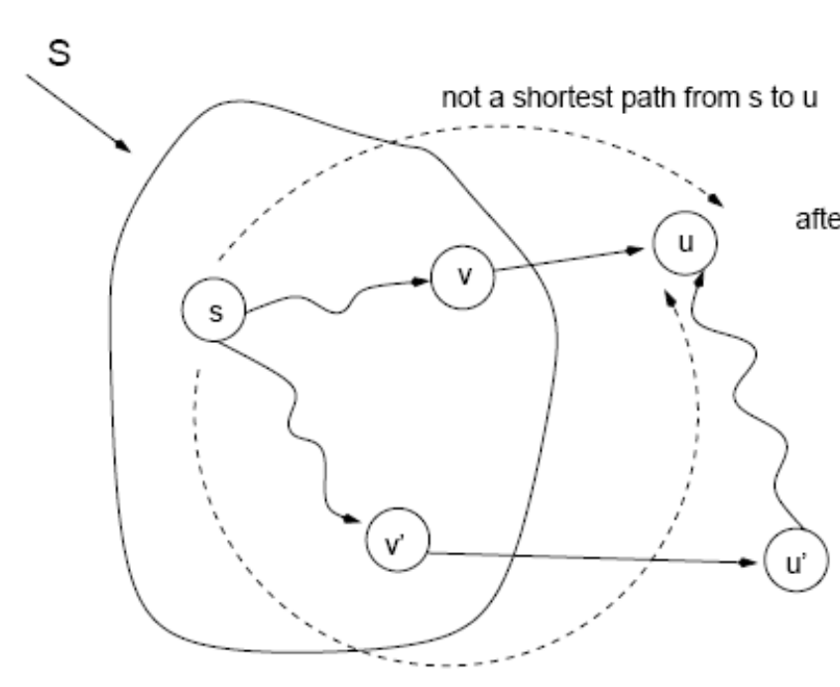
Correctness of Dijskstra’s Algorithm
What is the value of d[u]?
d[u]≤d[v]+w(v,u)= δ(s,v)+w(v,u)
What is the value of d[u’]?
d[u’]≤d[v’]+w(v’,u’)= δ(s,v’)+w(v’,u’)
Since u’ is in the shortest path of u: d[u’]<δ(s,u)
d[u’]<d[u]
Using the upper bound property: d[u]>δ(s,u)
Contradiction!
Priority Queue Q: <u, …, u’, ….> (i.e., d[u]<…<d[u’]<… )

Slide 37
All-Pairs Shortest Paths
Given:
  Directed graph G = (V, E)
  Weight function w : E → R
Compute:
  The shortest paths between all pairs of vertices in a graph
  Result: an n × n matrix of shortest-path distances δ(u, v)
2
3
4
1
8
3
2
-4
1
-5
7
5
4
6

Slide 38
All-Pairs Shortest Paths - Solutions
Run BELLMAN-FORD once from each vertex:
  O(V²E), which is O(V⁴) if the graph is dense (E = Θ(V²))
If no negative-weight edges, could run Dijkstra’s algorithm once from each vertex:
  O(VElgV) with binary heap, O(V³lgV) if the graph is dense
We can solve the problem in O(V³), with no elaborate data structures

Slide 39
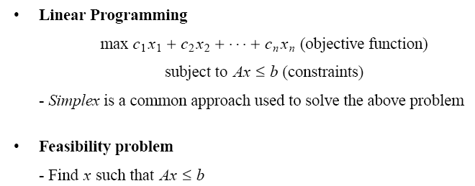
Application: Feasibility Problem

Slide 40
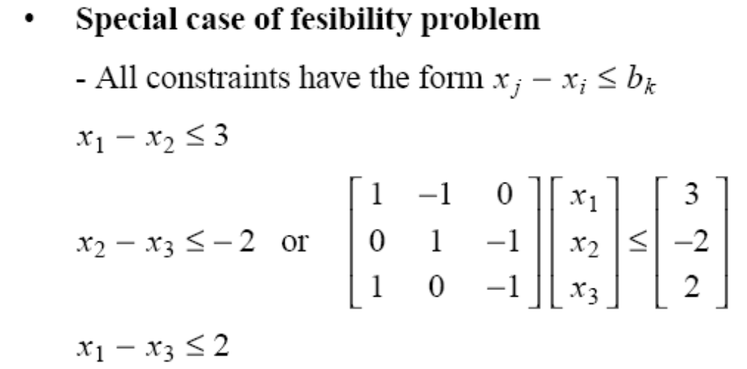
Application: Feasibility Problem (cont.)

Slide 41
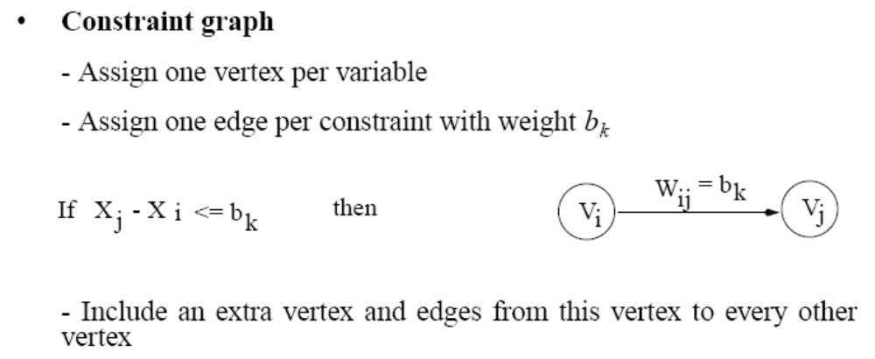
Application: Feasibility Problem (cont.)

Slide 42
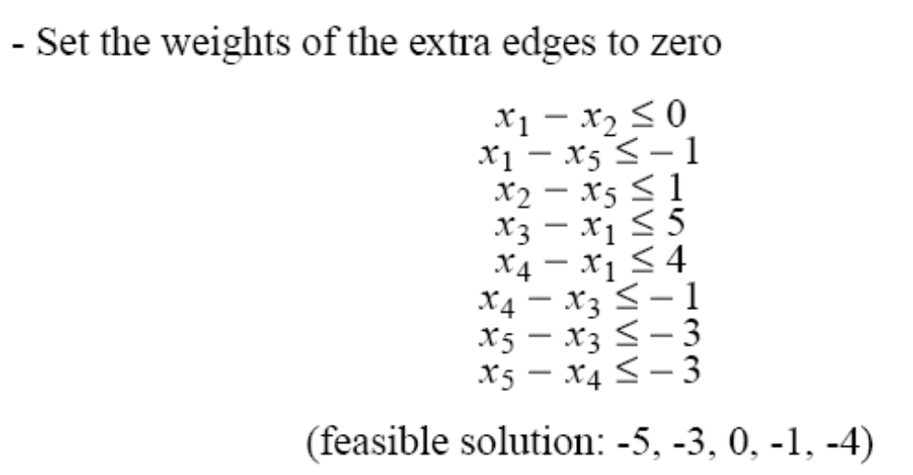

Application: Feasibility Problem (cont.)
-1
x₁
0
x₂
5
0
4
0
x₀
0
1
x₃
0
-1
0
-3
x₅
x₄
-3

Slide 43
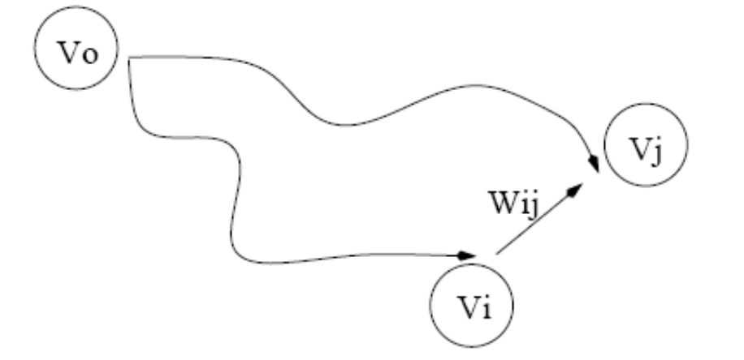
Application: Feasibility Problem (cont.)
Theorem: If G contains no negative cycles, then
(δ(v₀,v₁), δ(v₀,v₂),…, δ(v₀,v_{n})) is a feasible solution.
For every (v_{i}, v_{j}): δ(v₀,v_{j})≤ δ(v₀,v_{i})+w(v_{i},v_{j})
or δ(v₀,v_{j}) - δ(v₀,v_{i}) ≤ w(v_{i},v_{j})
Setting x_{i}= δ(v₀,v_{i}) and x_{j}= δ(v₀,v_{j}), we have
x_{j}-x_{i}≤ w(v_{i},v_{j})

Slide 44
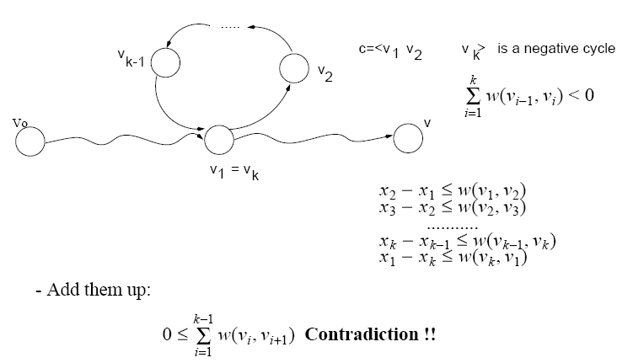
Application: Feasibility Problem (cont.)
Theorem: If G contains a negative cycle, then there is no feasible solution.
Proof by contradiction: suppose
there exist a solution, then:

Slide 45
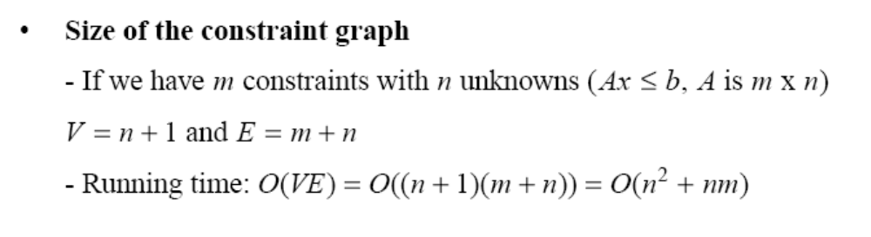
Application: Feasibility Problem (cont.)

Slide 46
Problem 1
Write down weights for the edges of the following graph, so that Dijkstra’s algorithm would not find the correct shortest path from s to t.
s
1
u
1
w
1
-1
1st iteration
v
d[s]=0
d[u]=1
d[v]=1
2nd iteration
3rd iteration
4th iteration
d[w]=2
d[u]=0
S={s} Q={u,v,w}
S={s,u} Q={v,w}
S={s,u,v} Q={w}
S={s,u,v,w}
Q={}
d[w] is not correct!
d[u] should have converged when u was included in S!

Slide 47
Problem 2
(Exercise 24.3-4, page 600) We are given a directed graph G=(V,E) on which each edge (u,v) has an associated value r(u,v), which is a real number in the range 0≤r(u,v) ≤1 that represents the reliability of a communication channel from vertex u to vertex v.
We interpret r(u,v) as the probability that the channel from u to v will not fail, and we assume that these probabilities are independent.
Give an efficient algorithm to find the most reliable path between two given vertices.

Slide 48
Problem 2 (cont.)
Solution 1: modify Dijkstra’s algorithm
  Perform relaxation as follows:
if d[v] < d[u] w(u,v) then
d[v] = d[u] w(u,v)
  Use “EXTRACT_MAX” instead of “EXTRACT_MIN”

Slide 49
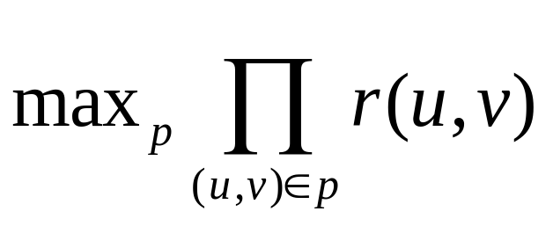
Problem 2 (cont.)
Solution 2: use Dijkstra’s algorithm without any modifications!
  r(u,v)=Pr( channel from u to v will not fail)
  Assuming that the probabilities are independent, the reliability of a path p=<v₁,v₂,…,v_{k}> is:
r(v₁,v₂)r(v₂,v₃) … r(v_{k-1},v_{k})
  We want to find the channel with the highest reliability, i.e.,

Slide 50
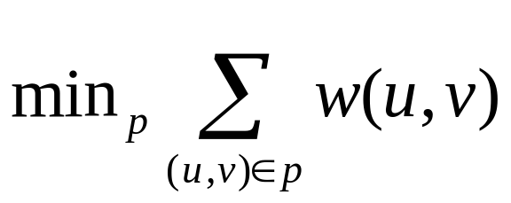
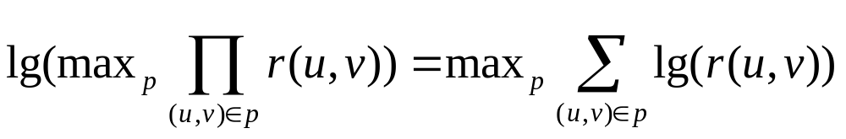
Problem 2 (cont.)
But Dijkstra’s algorithm computes
Take the lg

Slide 51
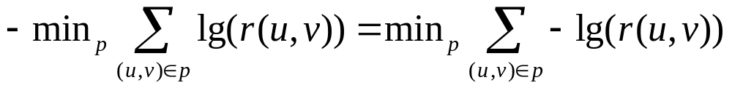

Problem 2 (cont.)
Turn this into a minimization problem by taking the negative:
Run Dijkstra’s algorithm using

